Slide 1
Volcanic avalanche in japan
By Snorre

Slide 2
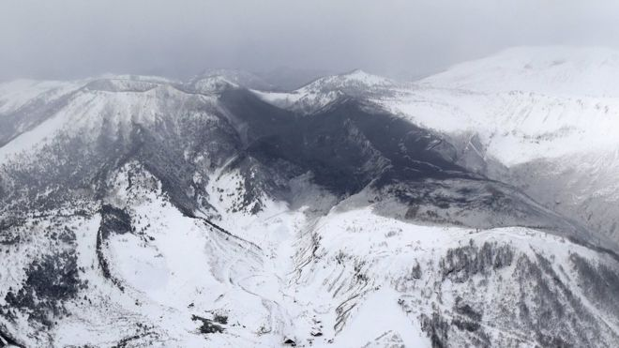
Volcanic eruption in Japan
A volcanic eruption next to a ski resort in Japan, Kasatsu near central Gunma resulted in an avalanche that killed 1 person and injured 14 others. 6 members of the military who were exercising were rescued from the avalanche. The volcano flung rocks up to 1km away from the mountain and about 100 people were evacuated.

Slide 3
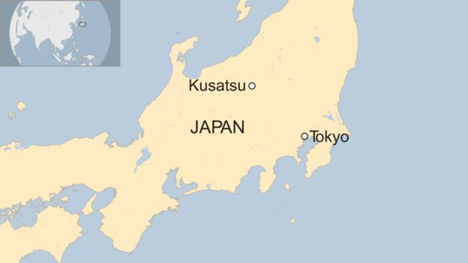
Aftermath
78 skiers were trapped at a rest house after the avalanche. Only 5 out of the 6 military soldiers came out alive.
“The eruption that caused the avalanche may not be the last.” says Japan’s meteorological department

